Slide 1
NPTEL
Video Course on Machine Learning
Professor Carl Gustaf Jansson, KTH
Week 4 Inductive Learning based on
Symbolic Representations
and Weak Theories
Video 4.5 Cluster Analysis

Slide 2
Agenda for the Lecture
Clustering Analysis in general
Hyperparameters
Distance measures
Categories of clustering algorithms:
Partitioning–based clustering
Hierarchical-based Clustering
Density-based clustering
Grid-based clustering
Model-based clustering

Slide 3
Cluster analysis is an important element in unsupervised concept learning, i.e. learning of multiple concepts from unsorted examples
Apart from being an important methodology for preprocessing of datasets in the unsupervised machine learning scenario, Cluster Analys can be used as a stand alone technique for particular categorization purposes.
As instances are not classified in the unsupervised scenario, algorithms have to identify commonalities and structures in the data-set and to group the instances based on similarity.
The detailed concept formation can then be performed by any of techniques for supervised learning ( scenario 1-10 as of an earlier lecture).

Slide 4
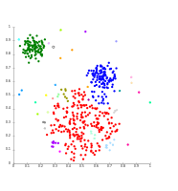
Cluster Analysis
Synonyms: Clustering, Conceptual Clustering, Clustering techniques
Cluster analysis is the task of grouping a set of objects in such a way that objects in the same group called a cluster are more similar (in some sense) to each other than to those in other groups (clusters).
Cluster analysis can be achieved by various algorithms that differ significantly in their understanding of what constitutes a cluster and how to efficiently find them.
There are possibly over 100 published clustering algorithms.
Typically clustering algorithms are dependent on several hyper parameter settings. Potentially the parameter settings can also be automated based on separate learning processes.

Slide 5
Examples of hyper parameters that may
need to be specified for Clustering algorithms
Number of Clusters to establish
Number of features used to describe instances
Type of distance measure to employ
Treshold for maximum distance between instances and
minimum numbers of instances that satisfies that treshold
as one kind of definition of density
Alternative density threshold measures
6. Number of sessions for inspection of the data-set

Slide 6
Distance and Similarity Metrices
Distance metrics have been described in the lecture on instance-based learning but has also a crucial role in Cluster Analysis. A distance metric (measure, function) is typically a real-valued function that quantifies the distance between two objects:
Distance metrics and similarity metrics have been developed more or less independently for different purposes, but usually specific similarity metrics are intuitively inverses of corresponding distance metrics and can be transformed into each other.
We will exemplify by:
Metrices in a normed Euclidean vector space
Minkovsky distance
Manhattan or taxicab distance = the Minkovsky distance with k=1.
Euclidean distance = the Minkovsky distance with k=2
Chebyshev or chessboard distance = the Minkovsky distance with k=inf.
Cosine similarity measure
Metrices based on overlapping elements
Levenshtein Distance
Jaccard Similarity, Index or Coefficient
Hamming distance

Slide 7
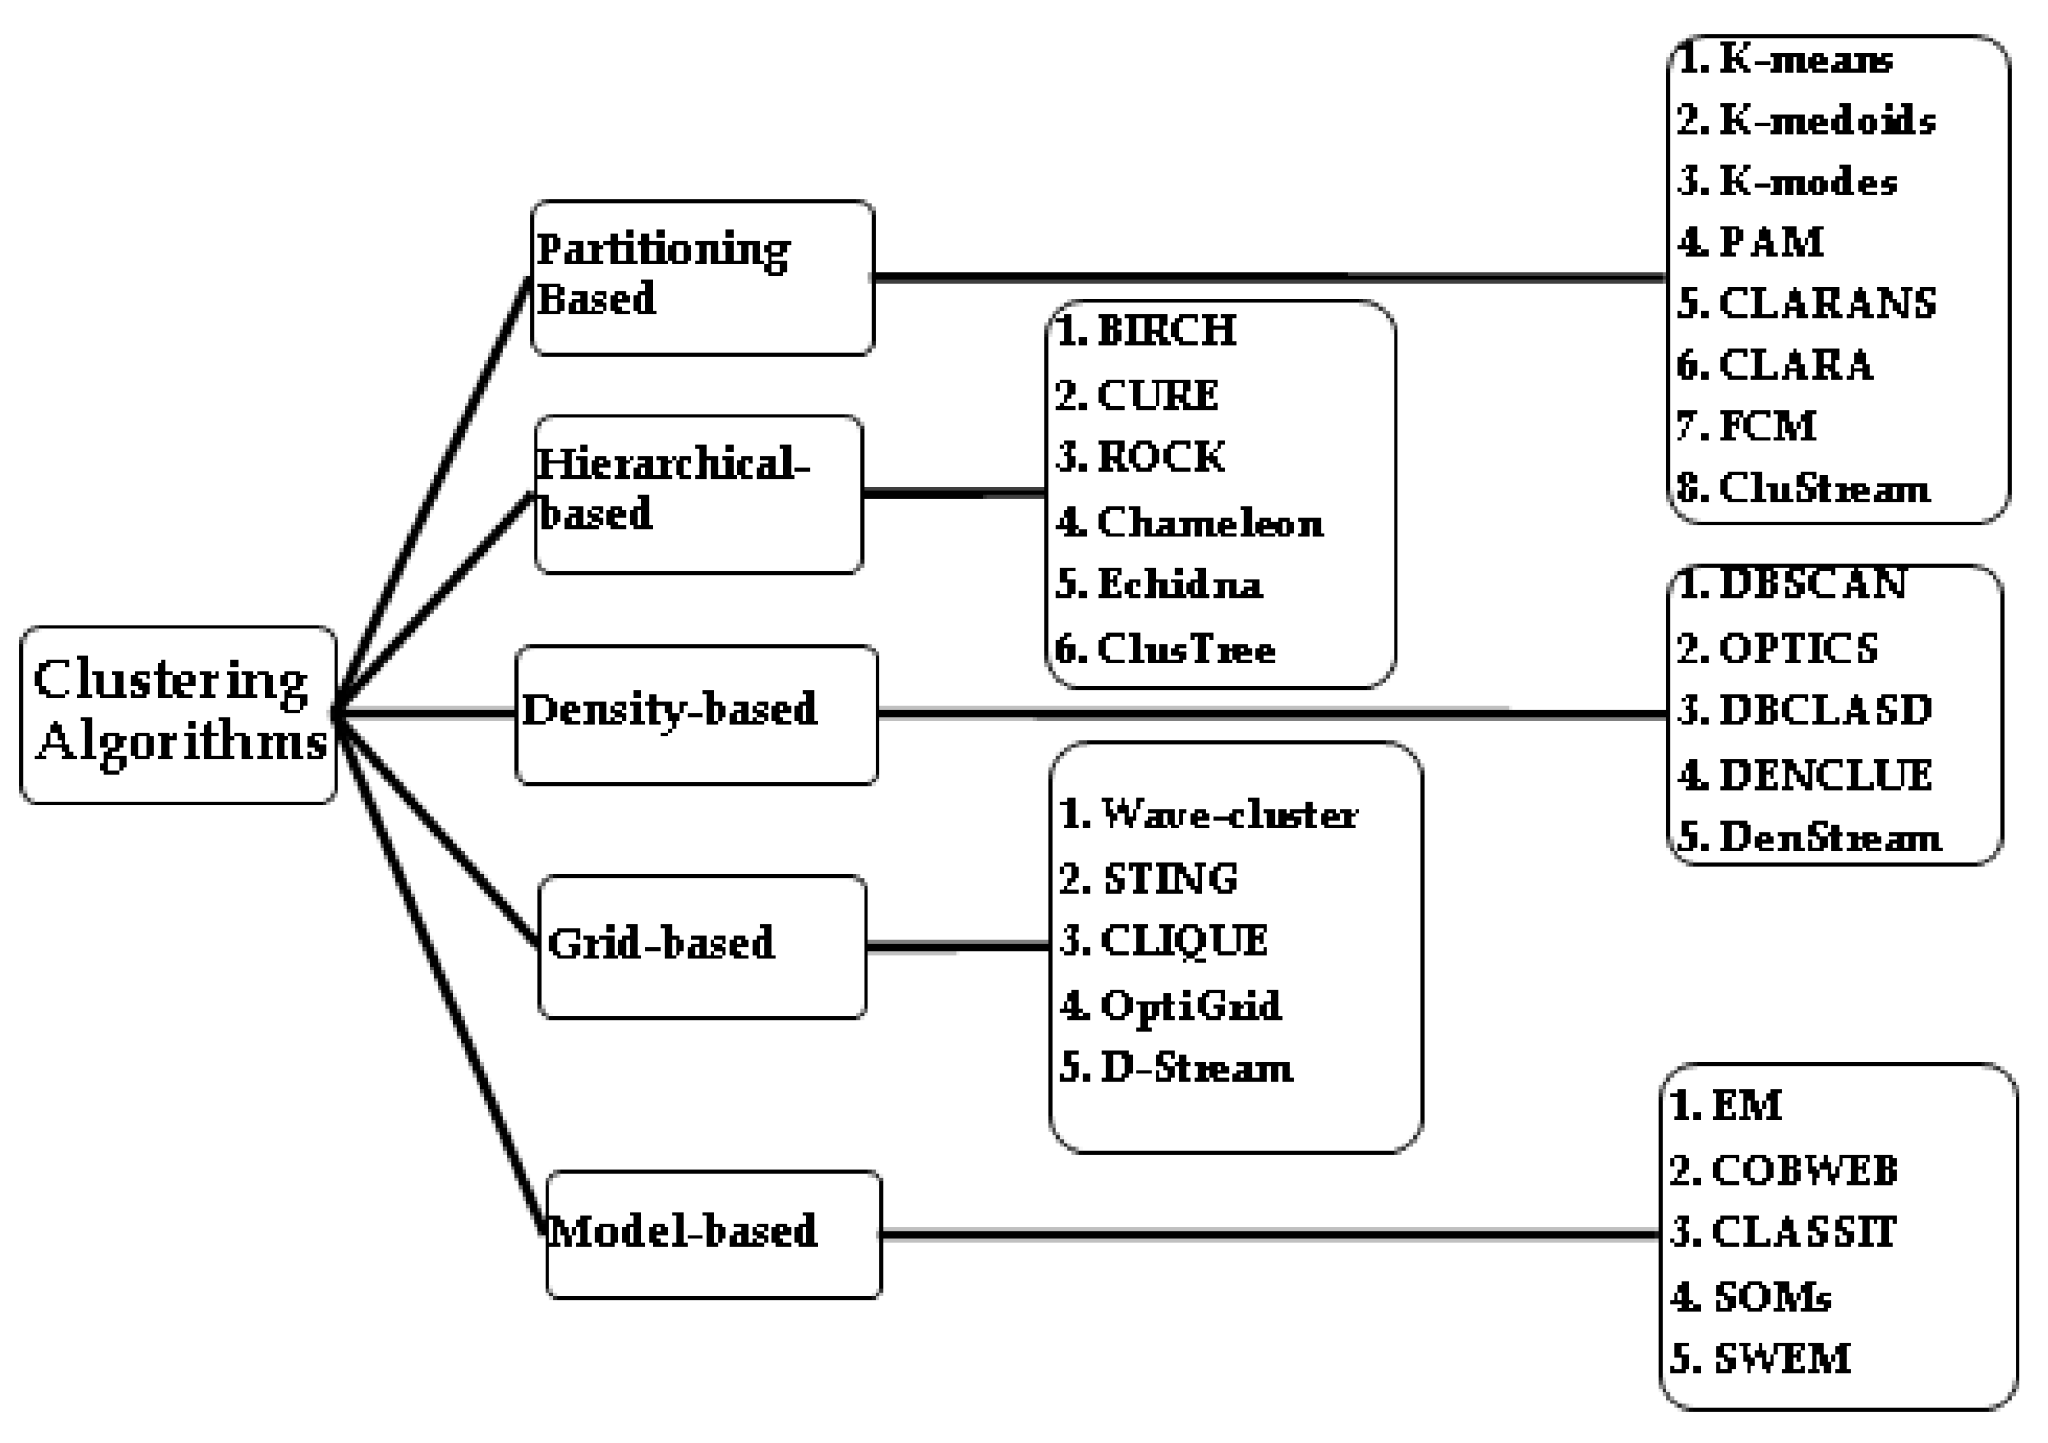
Categorization of Clustering Methods
The more than 100 published clustering algorithms can be clustered in many ways.
Below is depicted the structure chosen for this lecture

Slide 8
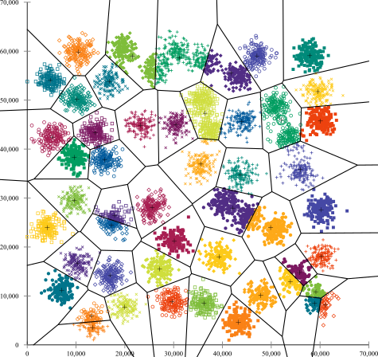
Partitioning-based Clustering
Partitioning algorithms are clustering techniques that subdivide the data sets into a set of k clusters.
A majority of partitioning algorithms are based on the selection of prototypical instances or synonymously centroid intances. These algorithms may be termed Centroid clustering techniques. In this approach, the selection of centroids are iteratively optimized and instances are iteratively reallocated to the closest centroid to ultimately form the resulting clusters.
The result can be illustrated in a partitioning of the data space in a Voronoi diagram.
Properties of the algorithms:
the target number of clusters = k needs to be preset, a sensitive choice
initial seeds have a strong impact on the final results
partitioning may produce tighter clusters than hierarchical approaches
Algorithms
K-means clustering
K-medio
CLARA

Slide 9
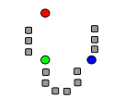
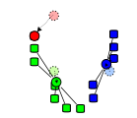
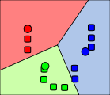
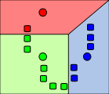
Partitioning–based clustering as exemplified by the approach in the k-means algorithm
Goal : partition N instances into k clusters.
Steps of the algorithm:
Select k instances and allocate these as initial means (centroids, prototypes)
Calculate the distance (typically Euclidean) from each instance to all the centroids
Associate all instances to the closest means (centroids, protype)
Let the resulting subsets of instances constitute the initial clusters
Create new means (centroids, prototype) as the centroid of all instances in each cluster
Recalculate and reallocate all instances. An instance can change cluster when the centroids are recomputed.
Reiterate from 4 until centroids remains stable.

Slide 10
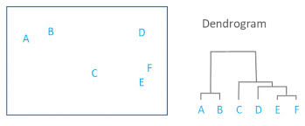
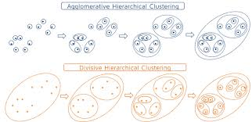
Hierarchical-based Clustering or Hierarchical clustering
Hierarchical clustering is a cluster technique which seeks to build a hierarchy of clusters. The results of the hierarchical clustering are usually presented in a dendrogram.
Properties of hierachical clustering:
It does not assume a particular value of 𝑘, as needed by e.g. 𝑘-means clustering.
The generated tree may correspond to a meaningful taxonomy= concept hierarchy.
A distance matrix is needed to compute the clustering steps.
Initial seeds have a strong impact on the final results as assignments cannot be undone iteratively
Very sensitive to outliers
Algorithms:
CURE
BIRCH
ROCK
Chameleon

Slide 11
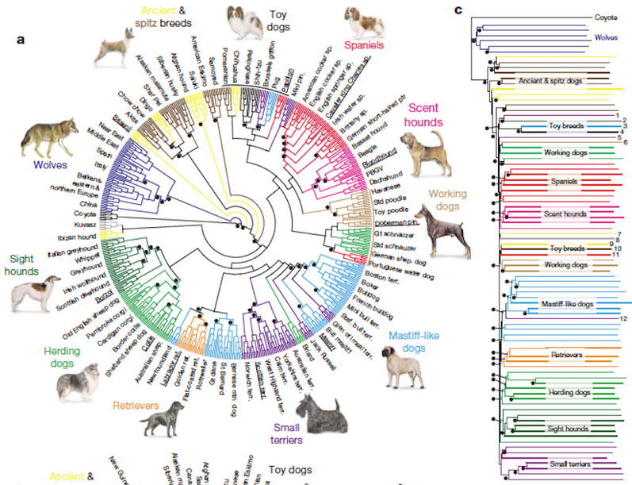
Dendrogram
A dendrogram is a diagram that shows the hierarchical relationship between objects.
It is most commonly created as an output from hierarchical clustering.
The main use of a dendrogram is to work out the best way to allocate objects to clusters.

Slide 12
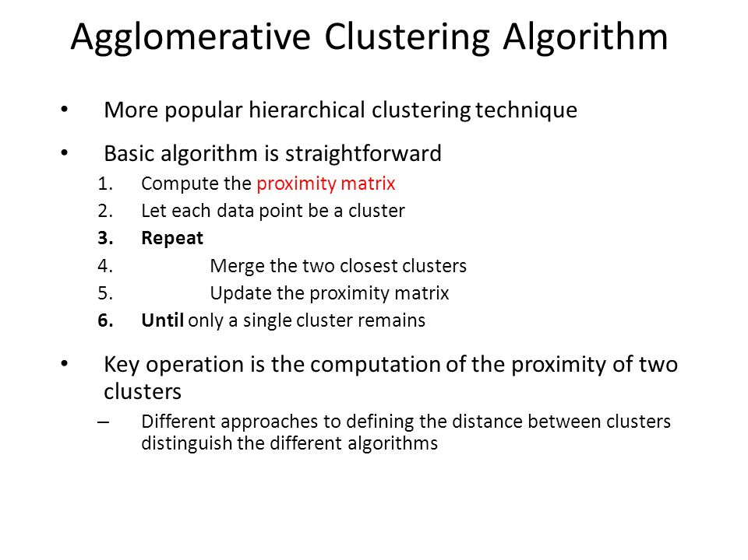
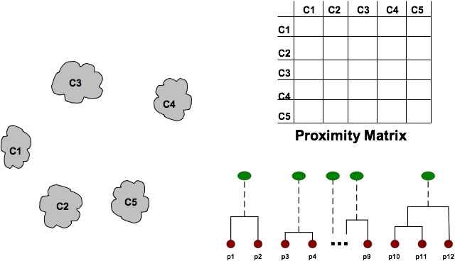
Hierarchical-based Clustering or Hierarchical clustering
Hierarchical clustering proceeds successively either in a:
Agglomerative fashion: a bottom-up approach where each observation starts in its own cluster, and pairs
of clusters are merged as one moves up the hierarchy
Divisive fashion: a top-down approach where all observations start in one cluster, and splits are performed
recursively as one moves down the hierarchy.
Splits and Merges are typically performed based on a proximity matrix between clusters.
Proximity of two clusters is the average of the distances between the instances in the two clusters.
A Proximity matrics for clusters can be calculated from a Distance Matrix for the instances.
The ´proximity´ matrix is recalculated in each step of the algorithm. In general, the merges and splits are determined in a greedy manner.

Slide 13
Density-based clustering
Density-based clustering is a clustering technique which groups together instances that are closely packed together (instances with many nearby neighbors), marking as outliers instances that lie alone in low-density regions (whose nearest neighbors are far away).
Properties of algorithms:
Clusters are dense regions in the instance space, separated by regions of lower instance density
A cluster is defined as a set of connected instances with maximal density
Does not need a predefined target value for # of clusters but needs
definitions of tresholds for reachability and density
Discovers clusters of arbitrary shape.
Is insensitive to noise.
Examples of algorithms:
DBSCAN
OPTICS

Slide 14
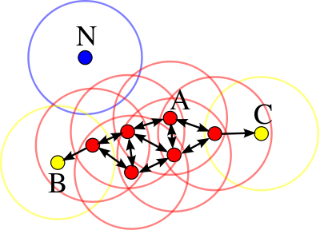
Density-based clustering as exemplified with the approach in DBSCAN
Instances are classified as core instances, reachable instances or outliers.
A core instance has a minimum numbers of instances with a treshold radius.
An instance is density reachable fram another instance if it is within a treshold radius from a core instance.
An instance is density connected to another instance if both instances are density reachable from a third instance or if they are directly density reachable from each other.
All instances not reachable from any other instances are considered as outliers (possibly noise).
If p is a core instance, then it forms a cluster together with all instances that are reachable from it. Each cluster contains at least one core instance ; non-core points can be part of a cluster, but they form its "edge“.
All points within the cluster are mutually density-connected.
If a point is density-reachable from any point of the cluster, it is part of the cluster as well.
Point A and the other red instances are core instances,
because the area surrounding these instances in an
ε radius contain a specified minimum of 4 points
Because they are all reachable from one another,
they form a single cluster. Points B and C are not core
points, but are reachable from A (via other core points)
and thus belong to the cluster as well.
Point N is a noise point that is neither
a core point nor directly-reachable.

Slide 15
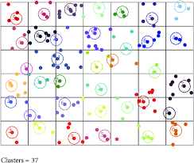
Grid-based clustering
Grid based methods quantize the instance space into a finite number of cells (hyper-rectangles) and then perform the required operations on the quantized space.
Typical steps in algoritms:
Define a set of grid-cells
Assign instances to grid cells and compute densities of cells
Eliminate cells that have densities below a certain threshold
Form clusters from adjacent cells based upon some objective (optimization) function.
Examples of algorithms:
CLIQUE (CLustering In QUEst)
STING (STatistical INformation Grid)
Wave Cluster

Slide 16
Model-based clustering
Model-based Clustering means that clustering is based on some model or background knowledge about the domain from which the instances of the dataset is harvested.
The model can be more or less extensive but can in all cases guide the clustering process. Model-based clustering can in principle be an extension to any of the other clustering approaches.
If the domain knowledge is some statistical information about the distributions for the various kinds of instances involved one can call this kind of clustering techniques Distribution-based clustering.
Example of a distribution based clustering scenario:
• Sample instances arise from a distribution that is a mixture of two or more components.
• Each component is described by a density function and has an associated probability or “weight” in the mixture.
• In principle, we can adopt any probability model for the components, but typically we will assume that components are p-variate normal distributions.
• Thus, the probability model for clustering will often be a mixture of multivariate normal distributions.
• Each component in the mixture is what we call a cluster.

Slide 17
NPTEL
Video Course on Machine Learning
Professor Carl Gustaf Jansson, KTH
Thanks for your attention!
The next lecture 4.6 will be on the topic:
Tutorial for Week 4

